Slide 1
Multiplying Matrices

Slide 2


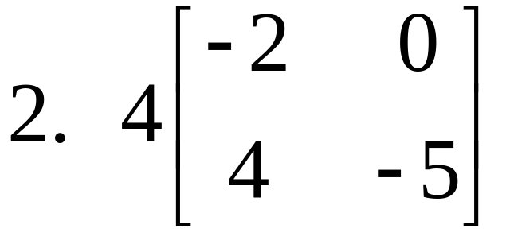
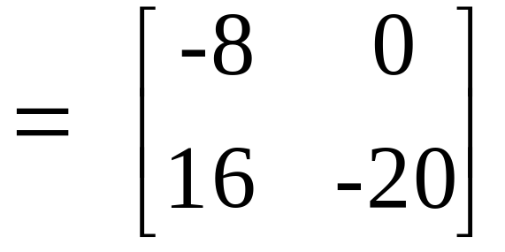
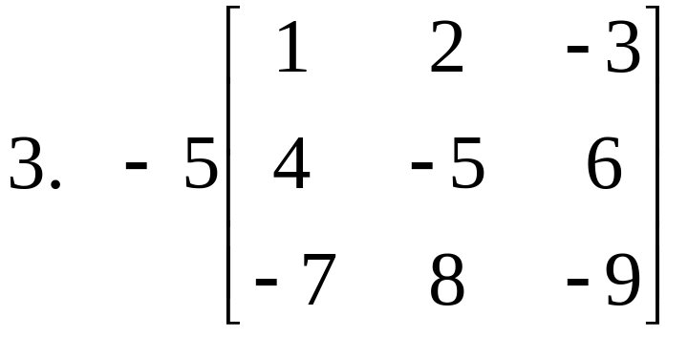
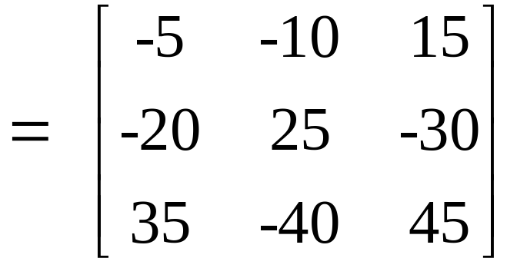
Scalar Multiplication - each element in a matrix is multiplied by a constant.

Slide 3
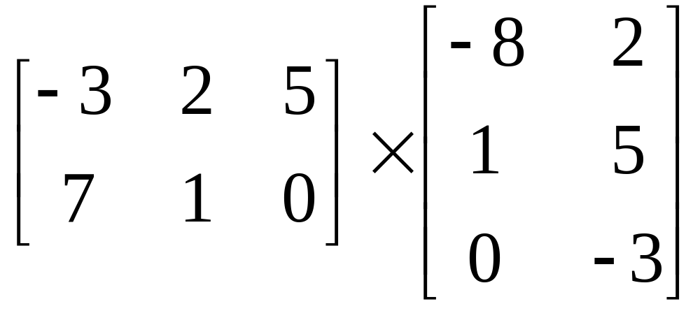
**Multiply rows times columns.
**You can only multiply if the number of columns in the 1st matrix is equal to the number of rows in the 2nd matrix.
They must match.
Dimensions:
2 x 3
3 x 2
The dimensions of your answer.

Slide 4
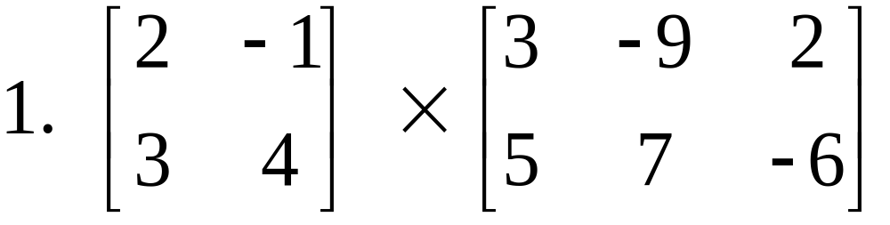
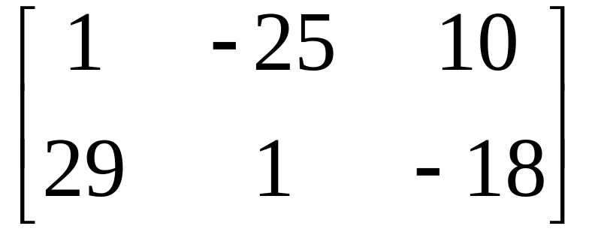
Examples:
2(3) + -1(5)
2(-9) + -1(7)
2(2) + -1(-6)
3(3) + 4(5)
3(-9) + 4(7)
3(2) + 4(-6)

Slide 5
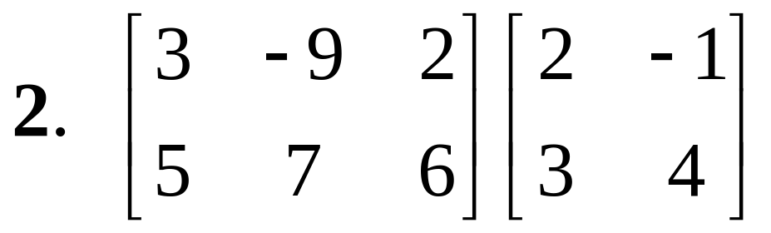
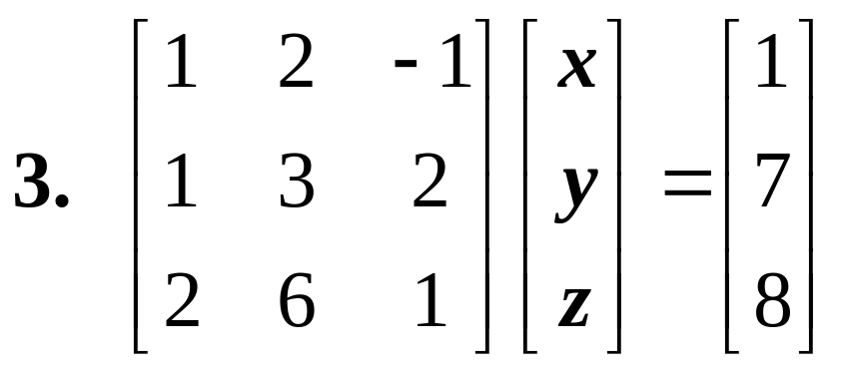
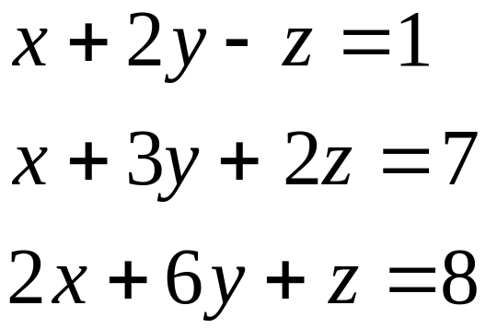
Dimensions: 2 x 3 2 x 2
*They don’t match so can’t be multiplied together.*

Slide 6
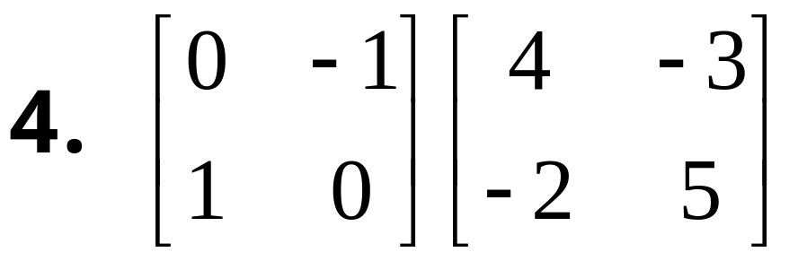
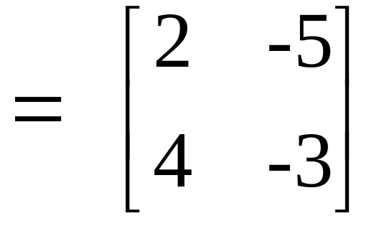
*Answer should be a 2 x 2
2 x 2 2 x 2
0(4) + (-1)(-2)
0(-3) + (-1)(5)
1(4) + 0(-2)
1(-3) +0(5)

Slide 7


